Slide 1
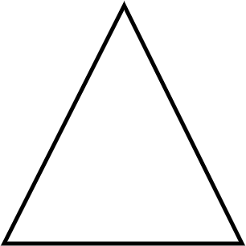
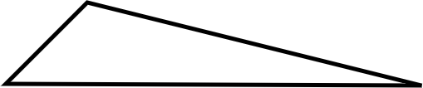


Problem solving with place value
Task A: Same measure, different units
Here is an important reminder about two types of triangles.
An isosceles triangle has two sides which are the same length.
A scalene triangle has no sides with the same length.
For each set of measurements, deduce if they are the lengths of a scalene or an isosceles triangle.
1) 1.739 m, 173.9 cm, 1793 mm
E.g. Only the lengths 1.739 m and 173.9 cm have the same digits in the same order. These are the lengths I need to check.
1.739 m × 100 = 173.9 cm
These lengths are the same. This is a set of lengths for an isosceles triangle.
2) 0.032 km, 3020 cm, 32 000 mm
E.g Only the lengths 0.032 km and 32 000 mm have the same digits in the same order. These are the lengths I need to check.
0.032 km × 1000 × 100 × 10 = 32 000 mm
These lengths are the same. This is a set of lengths for an isosceles triangle.
3) 5.1 cm, 0.000053 km, 50.3 mm
E.g. None of the lengths have the same digits in the same order. None of the lengths will be the same when converted.
None of the lengths are the same. This is a set of lengths for a scalene triangle.
4) Izzy has measured the sides of a triangle.
Why might you think that Izzy has made an error?
E.g. Izzy has measured one length in mm. This might be ok but when converted to cm, it is 0.93cm. This seems a lot smaller than the other measurements.
How could you check? E.g. I could remeasure that side to see if I get the same measurement again. I could try to draw a triangle with Izzy’s measurements.
I measured lengths of 31.2 cm, 24.9 cm and 9.3 mm

Slide 2
Problem solving with place value
Task B: Determining useful units of measure
1) Fill in the gaps using an appropriate unit of measure from the box.
I recently visited Paris. It took 2 hours and 37 minutes to get there by train. I visited the Eiffel Tower, which is 330 metres tall. Whilst at the Eiffel Tower, I visited a souvenir shop and bought 0.5 kilograms of sweets to share with my friends.
2) Which metric measures might be used to measure the following?
a) Length of an ant millimeters
b) Mass of a person kilograms
c) Capacity of a bucket litres
d) Height of a house metres
3) Which imperial measures might be used to measure the following?
a) Length of an ant inches
b) Mass of a person stones or pounds
c) Capacity of a bucket pints
d) Height of a house feet
Mathematics in Education and Industry
v2.2

